Slide 1
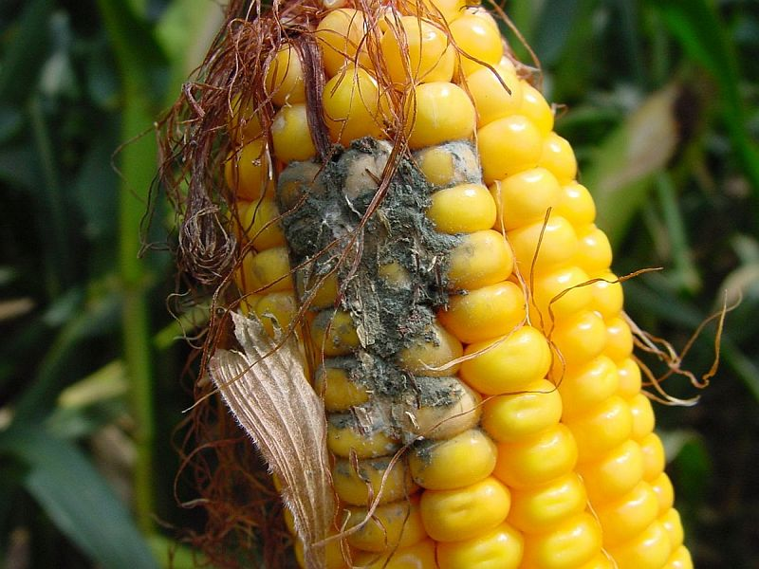
AFLATOXINS

Slide 2
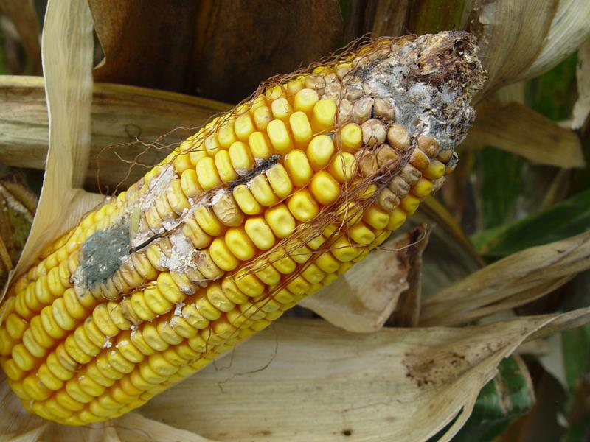
What are they?
A group of naturally occurring mycotoxins that are produced by Aspergillus flavus and Aspergillus parasiticus.
Usually gray-green or yellow-green in colour.

Slide 3
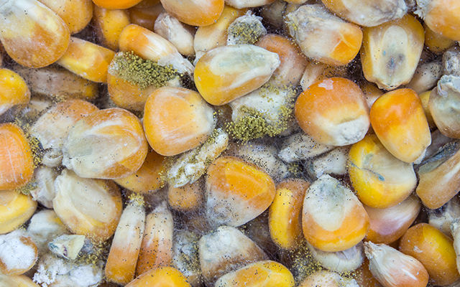
What causes aflatoxin growth?
Abiotic stress such as temperature, drought, soil stresses, tillage operations.
Biotic stresses such as insects and weeds.
Storage conditions, chemical treatments, spore infection density, presence of other microorganisms

Slide 4
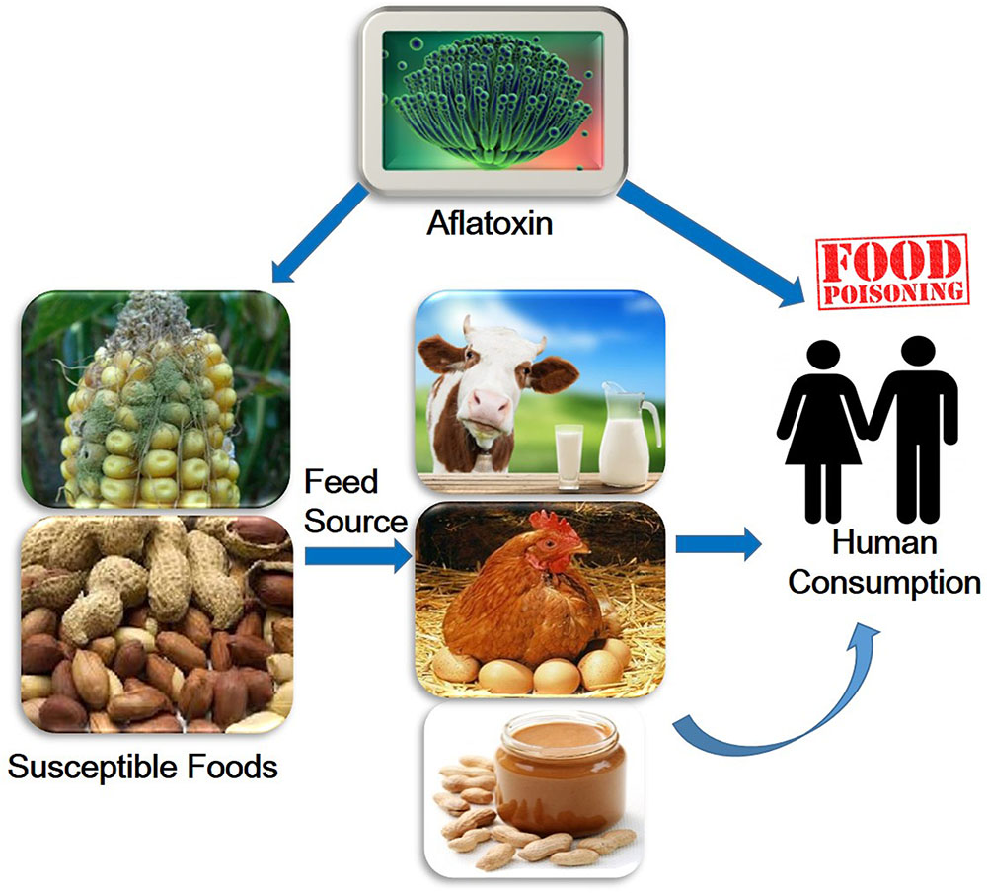
Effects of aflatoxins
Aflatoxins are capable of causing
Liver cancer (hepatocarcinogenic)
Mutation (mutagenic)
Deformities in developing embryos (teratogenic)

Slide 5
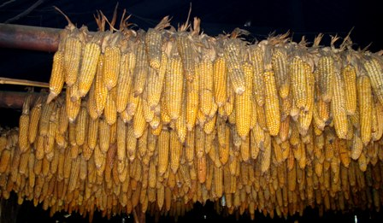
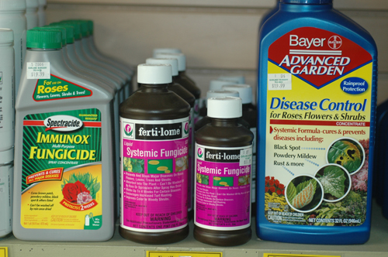
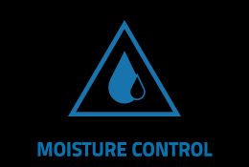
How to reduce aflatoxin growth
Moisture control
Prevent rodent and insect activity
Proper post-harvest processing and good storage, transportation and distribution methods
Using anti-mould preservatives or fungicides

Slide 6
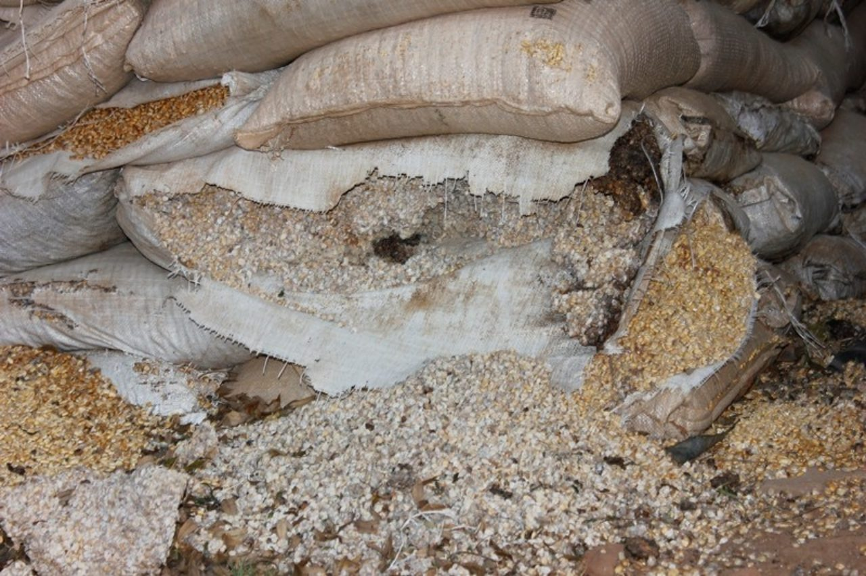
Moisture and aflatoxin growth
A limiting moisture level of 18% and an optimal temperature of 25 - 35˚C is suitable for aflatoxin growth.
Aflatoxin production increases during rewetting or when the leakage of a storage structure allows moisture to enter.

Slide 7
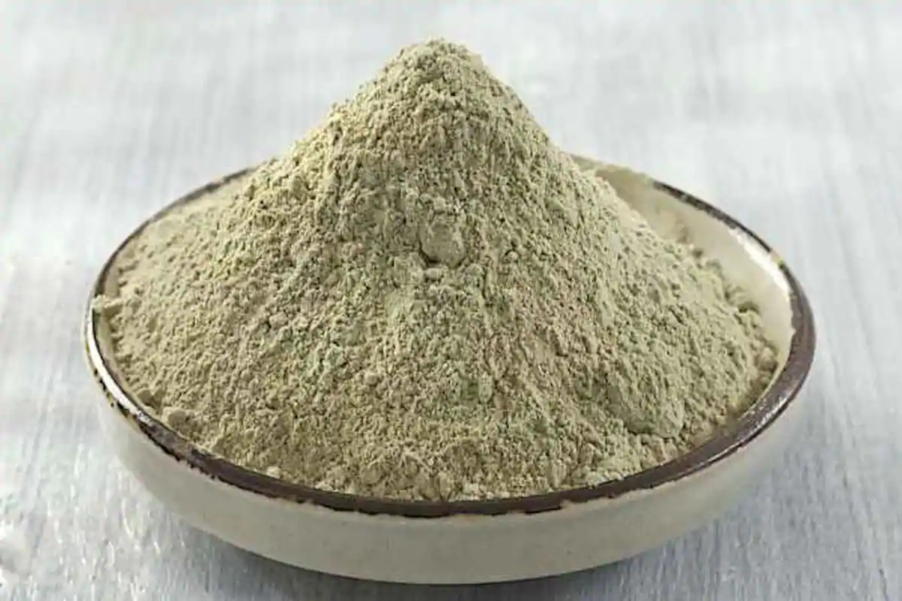
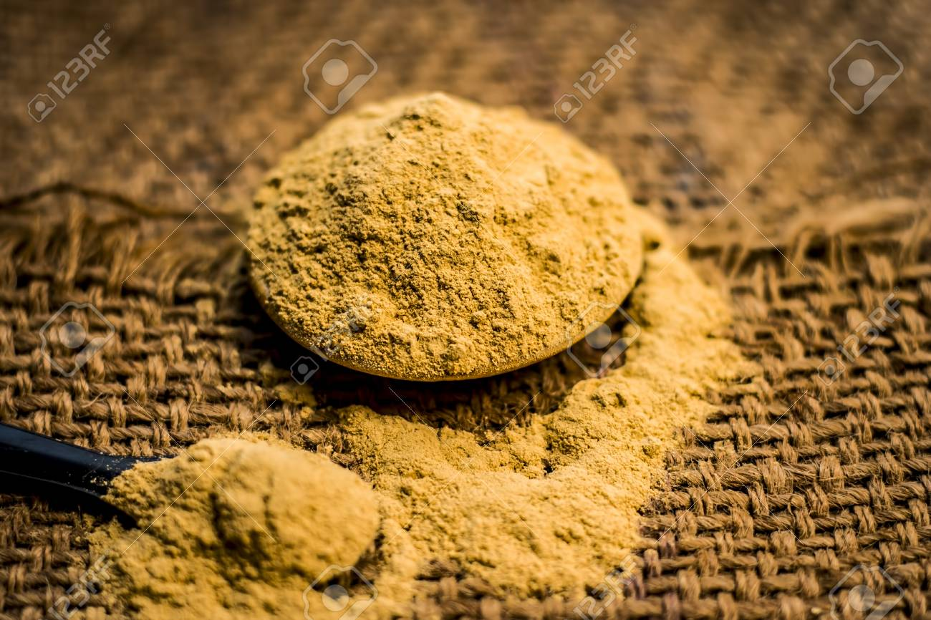
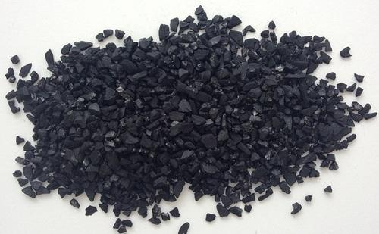
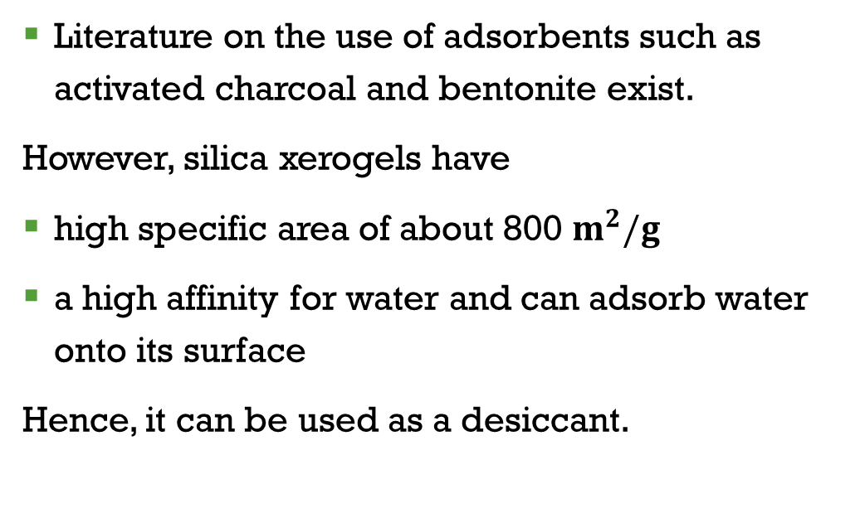
What we can do
Literature on the use of adsorbents such as activated charcoal and bentonite exist.
However, silica xerogels have
high specific area of about 800 $m^{2}/g$
a high affinity for water and can adsorb water onto its surface
Hence, it can be used as a desiccant.

Slide 8
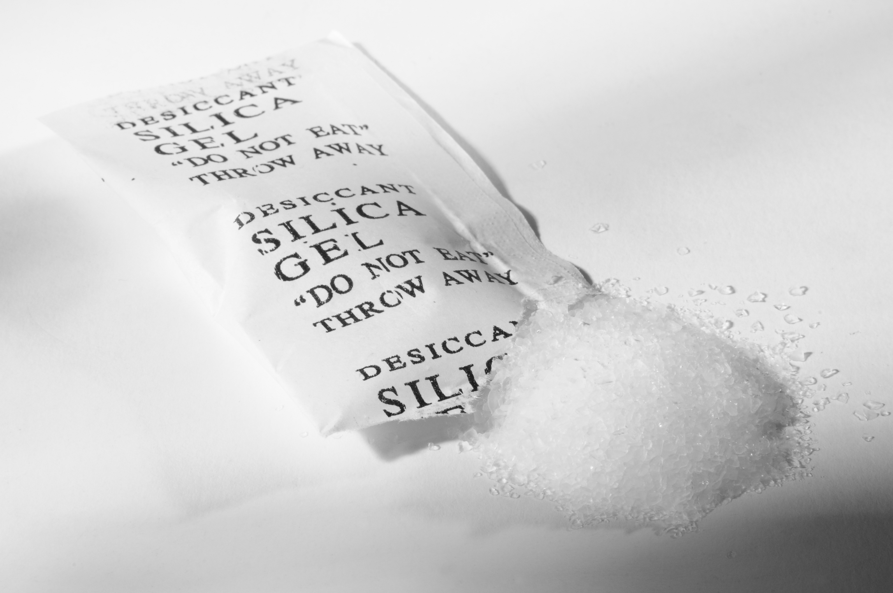
What we can do
We seek to
Prepare composite materials of silica gel and activated charcoal into bags for stacking in storage rooms to slow aflatoxin growth due to uncontrolled moisture.
Employ theoretical scientific models to predict the reduction growth.

Slide 9
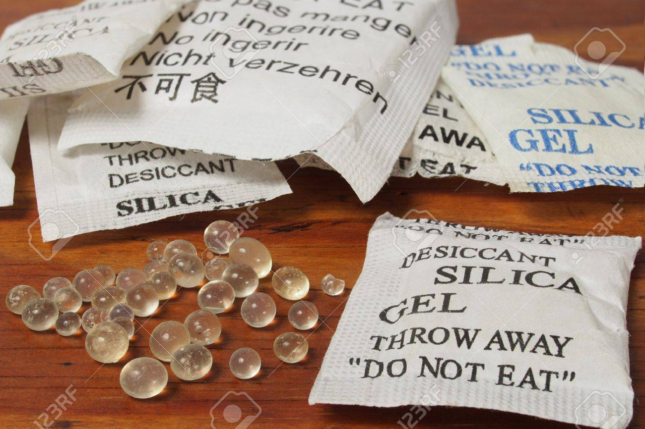
What we can do
We seek to
Validate the scientific models using real time experimental data to ascertain if the composite material has the tendency to detoxify aflatoxin contaminated feed.

Slide 10
THANK YOU

